Slide 1
COMPUTER FUNDAMENTALS Flowcharts

Slide 2
Learning Objectives
What is flowchart
Basic flowchart symbols
Sample flowchart
Levels of flowchart
Flowcharting rules
Advantages of flowchart
Limitation of flowchart

Slide 3
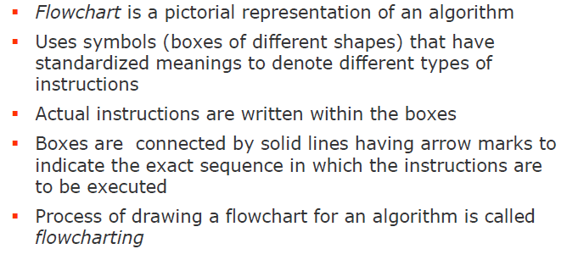
Flowchart

Slide 4
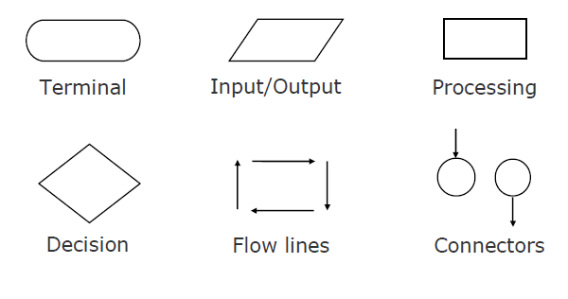
Basic Flowchart Symbols

Slide 5
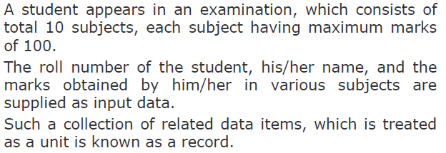
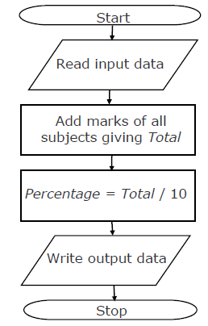
Sample Flowchart
Draw a flowchart to calculate the
Percentage marks obtained by the
Student in this examination and
Then to print it along with his/her
roll number and name

Slide 6
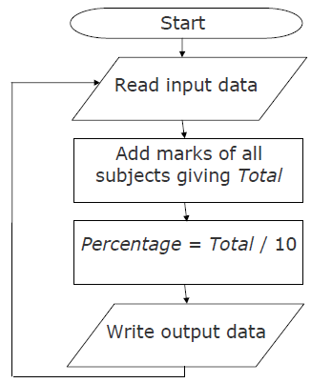
Sample Flowchart…
If 50 students of a class appear
in the examination of the previous
example
Draw a flowchart to calculate and
print the percentage marks
obtained by each student along
with his/her roll number and
name

Slide 7
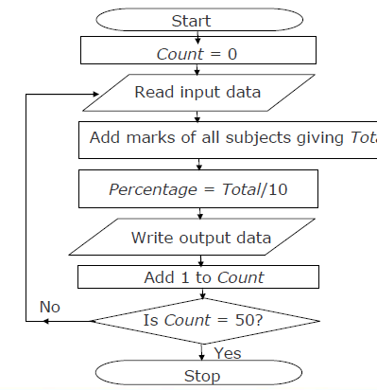
Sample Flowchart…

Slide 8
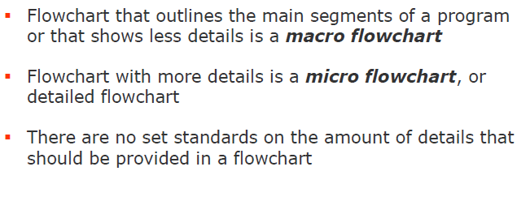
Levels of Flowchart

Slide 9
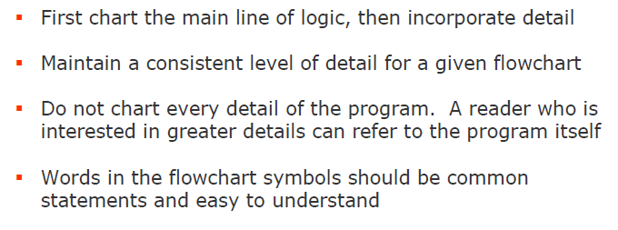
Flowcharting Rules

Slide 10
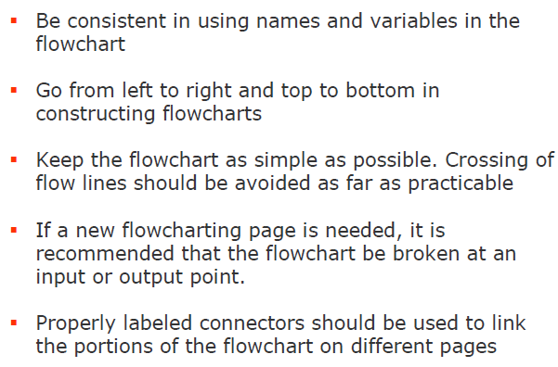
Flowcharting Rules (contd)…

Slide 11
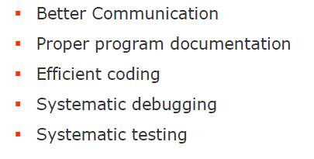
Advantages of Flowchart

Slide 12
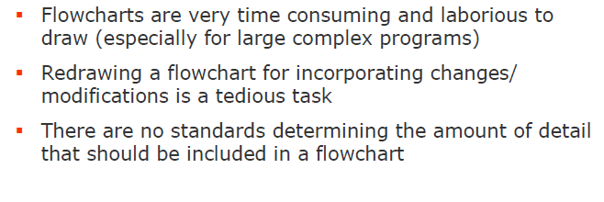
Limitations of Flowchart

Slide 13

THANK YOU

